Slide 1
Applied Statistics, Probability theory and mathematical statistics
István Fazekas, Attila Barta, Sándor Pecsora
Introduction to Matlab
”This work was supported by the construction EFOP-3.4.3-16-2016-00021. The project was supported by the European Union, co-financed by the European Social Fund.”

Slide 2
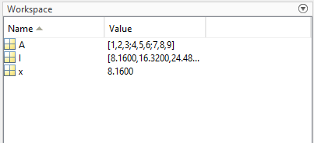
Variables in Matlab
Valid Names - A valid variable name starts with a letter, followed by letters, digits, or underscores. MATLAB® is case sensitive, so A and a are not the same variable. The maximum length of a variable name is the value that the namelengthmax command returns. You cannot define variables with the same names as MATLAB keywords, such as if or end. For a complete list, run the iskeyword command.
Create Variables - To create a new variable, enter the variable name in the Command Window, followed by an equal sign (=) and the value you want to assign to the variable. For example, if you run these statements, MATLAB adds the three variables x, A, and I to the workspace:
x = 8.16;
A = [1 2 3; 4 5 6; 7 8 9];
I = x*A;
You do not have to declare variables before assigning values to them. If you do not end the assignment statement with a semicolon (;), MATLAB displays the result in the Command Window.

Slide 3
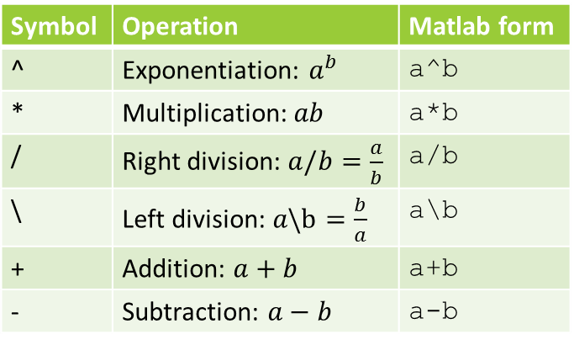
Scalar arithmetic operations
Symbol | Operation | Matlab form
^ | Exponentiation: $a^{b}$ | a^b
* | Multiplication: $ab$ | a*b
/ | Right division: $a/b=\frac{a}{b}$ | a/b
\ | Left division: $a\backslash b=\frac{b}{a}$ | a\b
+ | Addition: $a+b$ | a+b
- | Subtraction: $a−b$ | a-b

Slide 4
An Example Session
8/10
ans =
0.8000
r=8/10
r =
0.8000
r
r =
0.8000
s=20*r
s =
16

Slide 5
Order of precedence
Precedence | Operation
First | Parentheses, evaluated starting with the innermost pair.
Second | Exponentiation, evaluated from left to right.
Third | Multiplication and division with equal precedence, evaluated from left to right.
Fourth | Addition and subtraction with equal precedence, evaluated from left to right.

Slide 6
Examples of Precedence
8 + 3*5
ans =
23
8 + (3*5)
ans =
23
(8 + 3)*5
ans =
55
4^2­12­8/4*2
ans =
0
3*4^2 + 5
ans =
53
(3*4)^2 + 5
ans =
149
27^(1/3) + 32^(0.2)
ans =
5
27^(1/3) + 32^0.2
ans =
5

Slide 7
Commands for managing the work session
Command | Description
clc | Clears the Command window
clear | Removes all variables from memory
clear var1 var2 | Removes variables var1 and var2 from memory
exist(’name’) | Determines is a file or variable exists having the name ’name’

Slide 8
Complex Number Operations
The number c₁ = 1 – 2i is entered as follows: c1 = 1-­2i or c1 = 1-2*1i
• An asterisk is not needed between i or j and a number, although it is required with a variable, such as
c2 = 5*1i*c1
• Be careful. The expressions
y = 7/2*i
and
x = 7/2i
give two different results:
y = (7/2)i = 3.5i
and
x = 7/(2i) = –3.5i

Slide 9
Numeric display formats
Command | Description
format SHORT | Scaled fixed point format with 5 digits.
format LONG | Scaled fixed point format with 15 digits for double and 7 digits for single.
format SHORTE | Floating point format with 5 digits
format LONGE | Floating point format with 15 digits for double and 7 digits for single.
format SHORTG | Best of fixed or floating point format with 5 digits.
format LONGG | Best of fixed or floating point format with 15 digits for double and 7 digits for single.

Slide 10
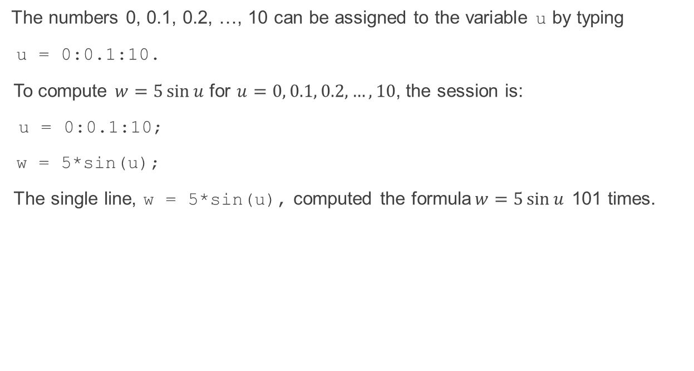
Arrays
The numbers 0, 0.1, 0.2, …, 10 can be assigned to the variable u by typing
u = 0:0.1:10.
To compute $w=5\sin{u}$ for $u=0, 0.1, 0.2,…, 10$, the session is:
u = 0:0.1:10;
w = 5*sin(u);
The single line, w = 5*sin(u), computed the formula$w=5\sin{u}$ 101 times.

Slide 11
Array Index
u(7)
ans =
0.6000
w(7)
ans =
2.8232
Use the length function to determine how many values are in an array.
m = length(w)
m =
101

Slide 12
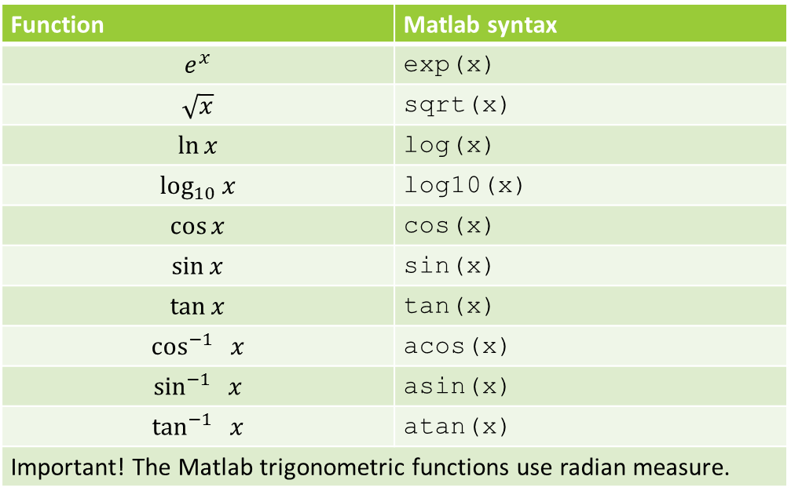
Some commonly used mathematical functions
Function | Matlab syntax
$$e^{x}$$ | exp(x)
$$\sqrt{x}$$ | sqrt(x)
$$\ln{x}$$ | log(x)
$$\log_{10}{x}$$ | log10(x)
$$\cos{x}$$ | cos(x)
$$\sin{x}$$ | sin(x)
$$\tan{x}$$ | tan(x)
$$\cos^{−1}{ x}$$ | acos(x)
$$\sin^{−1}{ x}$$ | asin(x)
$$\tan^{−1}{ x}$$ | atan(x)
Important! The Matlab trigonometric functions use radian measure.

Slide 13
Some Built-in functions
Function | Description
mean(A) | Average or mean value of A
max(A), min (A) | If A is a vector, then min(A) returns the smallest element of A. If A is a matrix, then min(A) is a row vector containing the minimum value of each column. max(A) works similarly, but with the maximum of A.
sum(A) | Summation of the elements of A
sort(A) | Sort in ascending or descending order.
median(A) | For vectors, median(a) is the median value of the elements in x. For matrices, median(A) is a row vector containing the median value of each column.
std(A) | Standard deviation
det(A) | Determinant of a square matrix
inv(A) | Inverse of the square matrix A
size(A) | D=size(A), for M-by-N matrix A, returns the two-element row vector D=[M,N] containing the number of rows and columns in the matrix.
length(A) | Returns the length of vector A. It is equivalent to MAX(SIZE(A)) for non-empty arrays and 0 for empty ones.
flip(A) | Flip the order of elements
prod(A) | P=prod(A)is the product of the elements of the vector A. If A is a matrix, P is a row vector with the product over each column.
Important! If A is a matrix, then some of these functions work differently, please check the helper.

Slide 14
Operators (relational, logical)
Operator | Description
== | Equal to
~= | Not equal to
< | Strictly smaller
> | Strictly greater
<= | Smaller than or equal to
>= | Greater than or equal to
& | And operator
| | Or operator

Slide 15
Vectors (One dimensional arrays)
To create a row vector, separate the elements by commas or spaces. Use square brackets:
p = [3,7,9]
p =
3 7 9
You can create a column vector by using the transpose notation (').
p = [3,7,9]'
p =
3
7
9
You can also create a column vector by separating the elements by semicolons. For example,
g = [3;7;9]
g =
3
7
9

Slide 16
You can create row vectors by ''appending'' one vector to another.
For example, to create the row vector u whose first three columns contain the values of
r = [2,4,20]
and whose fourth, fifth, and sixth columns contain the values of
w = [9,-6,3]
you type
u = [r,w]
The result is the vector
u = [2,4,20,9,-6,3]

Slide 17
You can create column vectors by ''appending'' one vector to another.
For example, to create the column vector u whose first three rows contain the values of
r = [2;4;20]
and whose fourth, fifth, and sixth rows contain the values of
w = [9;-6;3]
you type
u = [r;w]
The result is the vector
u = [2;4;20;9;-6;3]

Slide 18
The colon operator (:)
The colon operator (:) easily generates a large vector of regularly spaced elements.
Typing
x = m:q:n
or
x = (m:q:n)
creates a vector x of values with a spacing q. The first value is m. The last value is n if m-n is an integer multiple of q. If not, the last value is less than n.
For example, typing x = 0:2:8 creates the vector x = [0,2,4,6,8], whereas typing x = 0:2:7 creates the vector x = [0,2,4,6].
To create a row vector z consisting of the values from 5 to 8 in steps of 0.1, type z = 5:0.1:8
If the increment q is omitted, it is presumed to be 1. Thus typing y = -3:2 produces the vector y = [-3,-2,-1,0,1,2].

Slide 19
Creating vectors with the linspace command
The linspace command also creates a linearly spaced row vector, but instead you specify the number of values rather than the increment.
The syntax is linspace(x1,x2,n), where x1 and x2 are the lower and upper limits and n is the number of points.
For example, linspace(5,8,31) is equivalent to 5:0.1:8.
linspace Linearly spaced vector.
linspace(X1, X2) generates a row vector of 100 linearly equally spaced points between X1 and X2.
linspace(X1, X2, N) generates N points between X1 and X2.
For N = 1, linspace returns X2.

Slide 20
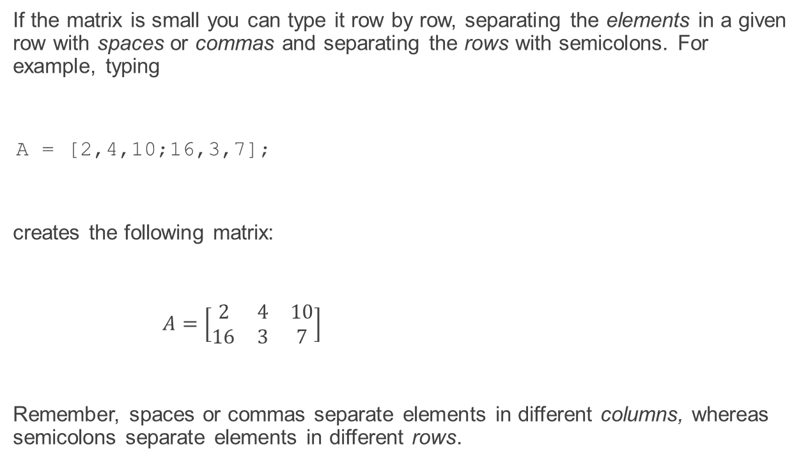
Matrices (Two dimensional arrays)
If the matrix is small you can type it row by row, separating the elements in a given row with spaces or commas and separating the rows with semicolons. For example, typing
A = [2,4,10;16,3,7];
creates the following matrix:
$A=\left[\begin{matrix}2 & 4 & 10 \\ 16 & 3 & 7\end{matrix}\right]$
Remember, spaces or commas separate elements in different columns, whereas semicolons separate elements in different rows.

Slide 21
Creating Matrices from Vectors
Suppose a = [1,3,5] and b = [7,9,11] (row vectors). Note the difference between the results given by [a b] and [a;b] in the following session:
c = [a b];
c =
1 3 5 7 9 11
D = [a;b]
D =
1 3 5
7 9 11

Slide 22
Array Addressing
The colon operator selects individual elements, rows, columns, or ''subarrays'' of arrays. Here are some
examples:
v(:) represents all the row or column elements of the vector v.
v(2:5) represents the second through fifth elements; that is v(2), v(3), v(4), v(5).
A(:,3) denotes all the elements in the third column of the matrix A.
A(:,2:5) denotes all the elements in the second through fifth columns of A.
A(2:3,1:3) denotes all the elements in the second and third rows that are also in the first through third columns.
v = A(:) creates a vector v consisting of all the columns of A stacked from first to last.
A(end,:) denotes the last row in A, and A(:,end) denotes the last column.

Slide 23
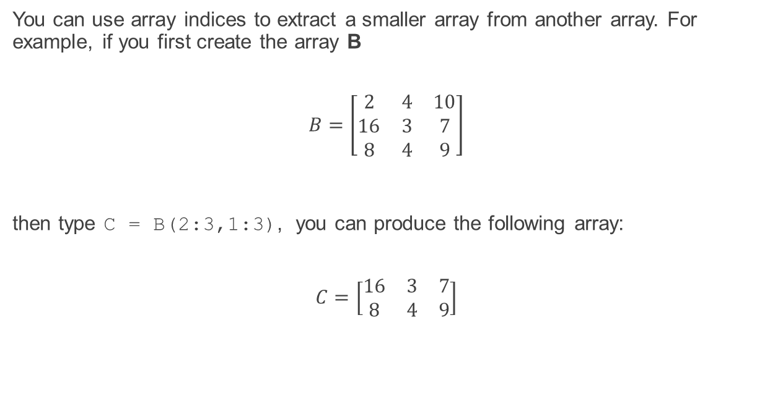
Arrays
You can use array indices to extract a smaller array from another array. For example, if you first create the array B
$$B=\left[\begin{matrix}2 & 4 & 10 \\ 16 & 3 & 7 \\ 8 & 4 & 9\end{matrix}\right]$$
then type C = B(2:3,1:3), you can produce the following array:
$$C=\left[\begin{matrix}16 & 3 & 7 \\ 8 & 4 & 9\end{matrix}\right]$$

Slide 24
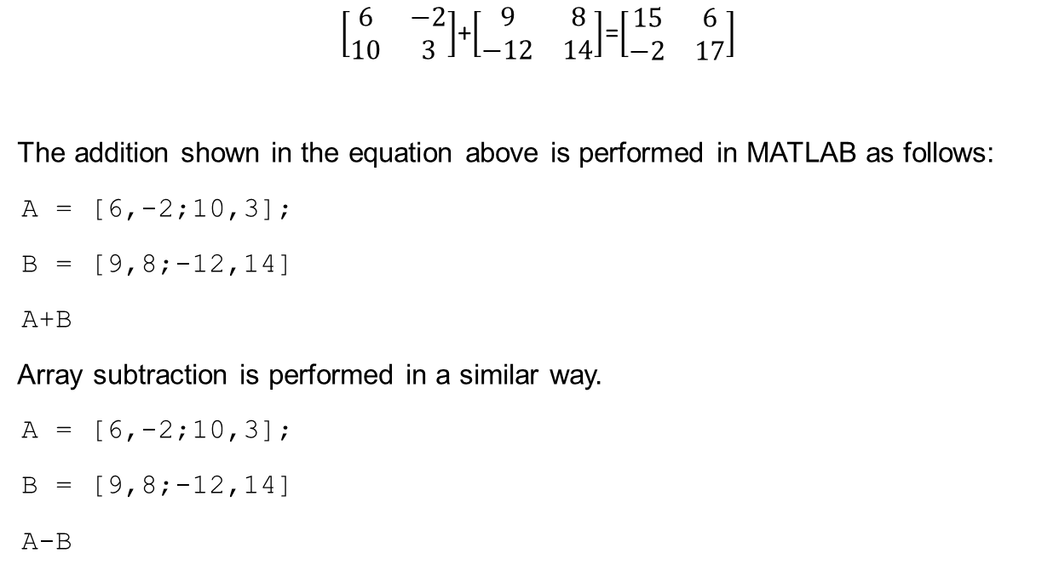
Array Addition and Subtraction
$\left[\begin{matrix}6 & −2 \\ 10 & 3\end{matrix}\right]$+$\left[\begin{matrix}9 & 8 \\ −12 & 14\end{matrix}\right]$=$\left[\begin{matrix}15 & 6 \\ −2 & 17\end{matrix}\right]$
The addition shown in the equation above is performed in MATLAB as follows:
A = [6,-2;10,3];
B = [9,8;-12,14]
A+B
Array subtraction is performed in a similar way.
A = [6,-2;10,3];
B = [9,8;-12,14]
A-B

Slide 25

Multiplication
Multiplying a matrix A by a scalar w produces a matrix whose elements are the elements of A multiplied by w.
$3\left[\begin{matrix}2 & 9 \\ 5 & −7\end{matrix}\right]=\left[\begin{matrix}6 & 27 \\ 15 & −21\end{matrix}\right]$
This multiplication is performed in MATLAB as follows:
A = [2, 9; 5,-7];
3*A
ans =
6 27
15 -21

Slide 26
Multiplication of two arrays
MATLAB uses two definitions of multiplication:
array multiplication (also called element-by-element multiplication), and
matrix multiplication.

Slide 27
Multiplication of two arrays
Element-by-element multiplication is performed in MATLAB as follows:
A = [6,-2;10,3];
B = [9,8;-12,14]
A.*B
ans =
54 -16
-120 42
Matrix multiplication is performed in MATLAB as follows:
A = [6,-2;10,3];
B = [9,8;-12,14]
A*B
ans =
78 20
54 122

Slide 28
Element-by-element operations
Symbol | Operation | Form | Examples
+ | Scalar-array addition | A+b | [6,3]+2=[8,5]
- | Scalar-array subtraction | A-b | [8,3]-5=[3,-2]
+ | Array addition | A+B | [6,5]+[4,8]=[10,13]
- | Array subtraction | A-B | [6,5]-[4,8]=[2,-3]
.* | Array multiplication | A.*B | [3,5].*[4,8]=[12,40]
./ | Array right division | A./B | [2,5]./[4,8]=[2/4,5/8]
.\ | Array left division | A.\B | [2,5].\[4,8]=[2\4,5\8]
.^ | Array exponentiation | A.^B | 2.^[3,5]=[2^3,2^5] [3,5].^[2,4]=[3^2,5^4]

Slide 29
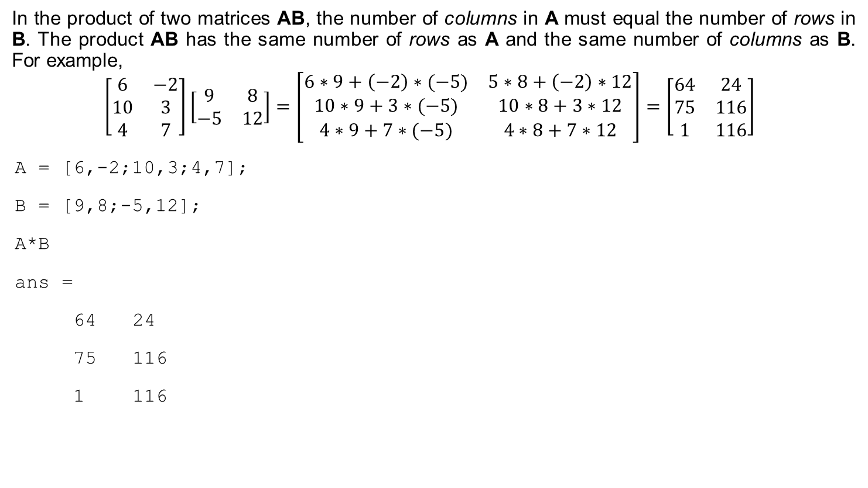
Matrix-Matrix Multiplication
In the product of two matrices AB, the number of columns in A must equal the number of rows in B. The product AB has the same number of rows as A and the same number of columns as B. For example,
$$\left[\begin{matrix}6 & −2 \\ 10 & 3 \\ 4 & 7\end{matrix}\right]\left[\begin{matrix}9 & 8 \\ −5 & 12\end{matrix}\right]=\left[\begin{matrix}6∗9+\left(−2\right)∗(−5) & 5∗8+\left(−2\right)∗12 \\ 10∗9+3∗(−5) & 10∗8+3∗12 \\ 4∗9+7∗(−5) & 4∗8+7∗12\end{matrix}\right]=\left[\begin{matrix}64 & 24 \\ 75 & 116 \\ 1 & 116\end{matrix}\right]$$
A = [6,-2;10,3;4,7];
B = [9,8;-5,12];
A*B
ans =
64 24
75 116
1 116

Slide 30
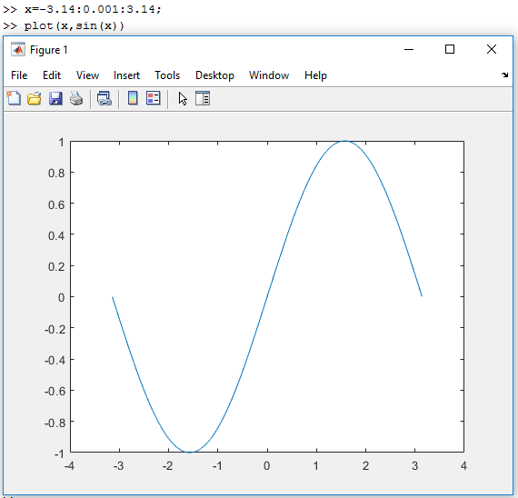
A graphics window showing a plot

Slide 31
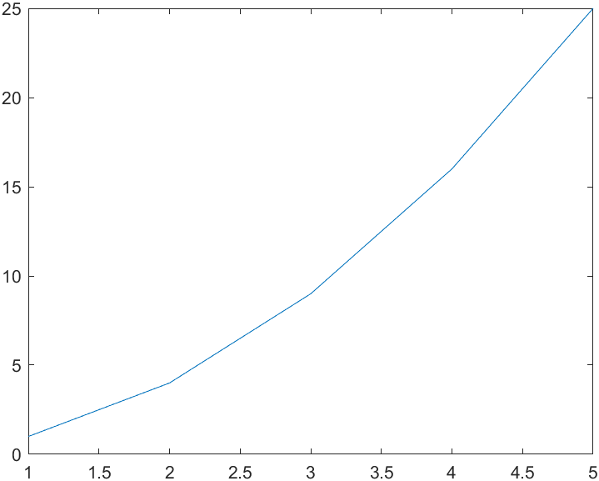
plot command in MATLAB
plot(X,Y) creates a 2-D line plot of the data in Y versus the corresponding values in X.
Example:
X=[1,2,3,4,5]
X =
1 2 3 4 5
Y=[1,4,9,16,25]
Y =
1 4 9 16 25
plot(X,Y)

Slide 32
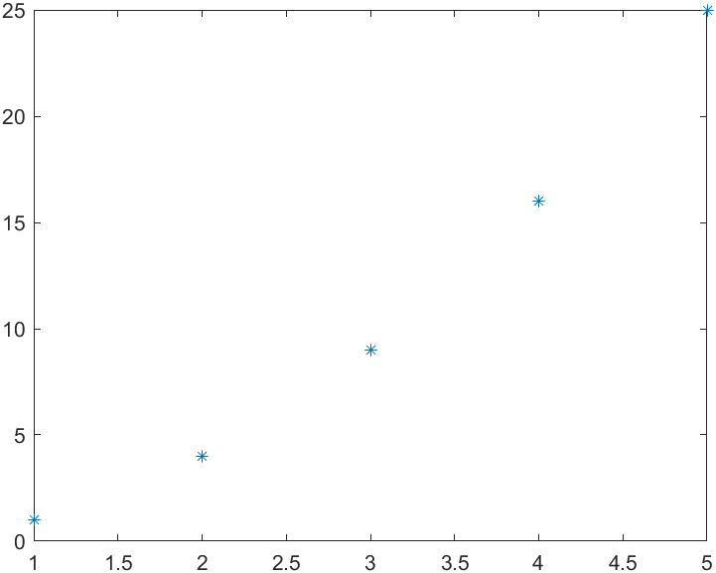
plot command in MATLAB
To plot the 5 point defined by X and Y, you can use for example the * marker.
Example:
X=[1,2,3,4,5]
X =
1 2 3 4 5
Y=[1,4,9,16,25]
Y =
1 4 9 16 25
plot(X,Y, '*')

Slide 33
plot line style, marker and colour
Line Style | Description
- | Solid line (default)
-- | Dashed line
: | Dotted line
-. | Dash-dot line
Marker | Description
o | Circle
+ | Plus sign
* | Asterisk
. | Point
x | Cross
s | Square
d | Diamond
^ | Upward-pointing triangle
v | Downward-pointing triangle
> | Right-pointing triangle
< | Left-pointing triangle
p | Pentagram
h | Hexagram
Colour | Description
y | yellow
m | magenta
c | cyan
r | red
g | green
b | blue
w | white
k | black

Slide 34
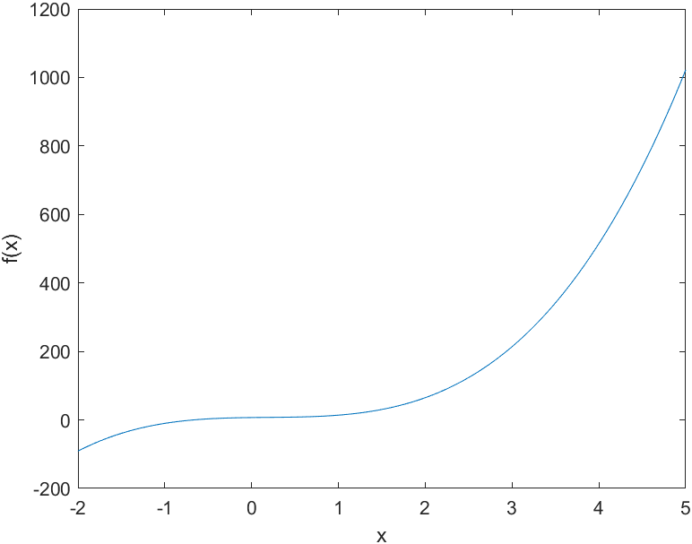
Plotting Polynomials
The function polyval(a,x)evaluates a polynomial at specified values of its independent variable x, which can be a matrix or a vector. The polynomial’s coefficients of descending powers are stored in the array a. The result is the same size as x.
Example of Plotting a Polynomial
To plot the polynomial f (x) = 9x³ – 5x² + 3x + 7 for -2 ≤ x ≤ 5, you type
a = [9,-5,3,7];
x = -2:0.01:5;
f = polyval(a,x);
plot(x,f),xlabel('x'),ylabel('f(x)')

Slide 35
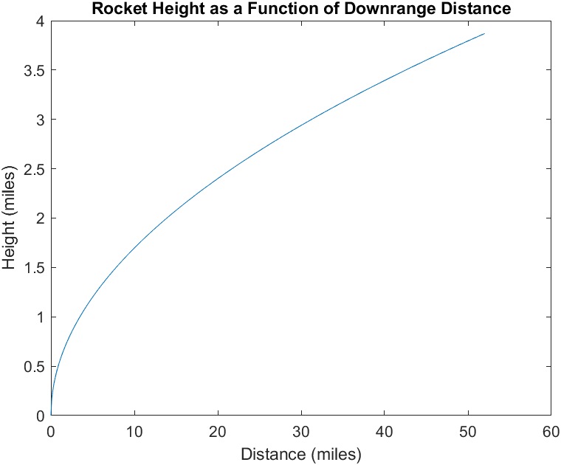
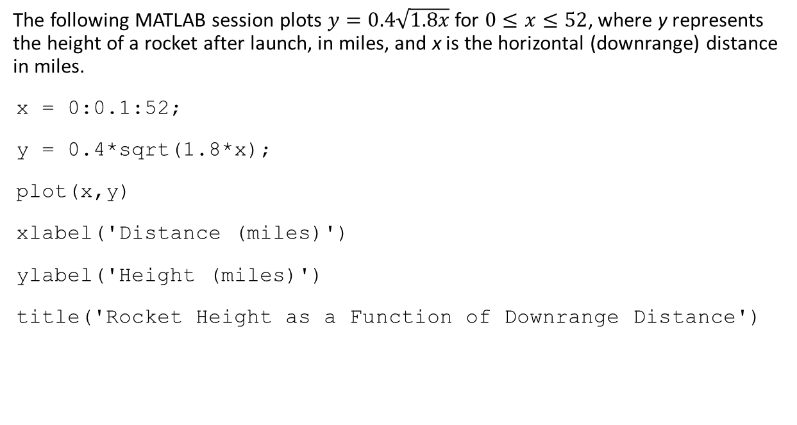
Plotting and labelling
The following MATLAB session plots $y=0.4\sqrt{1.8x}$ for $0≤x≤52$, where y represents the height of a rocket after launch, in miles, and x is the horizontal (downrange) distance in miles.
x = 0:0.1:52;
y = 0.4*sqrt(1.8*x);
plot(x,y)
xlabel('Distance (miles)')
ylabel('Height (miles)')
title('Rocket Height as a Function of Downrange Distance')

Slide 36
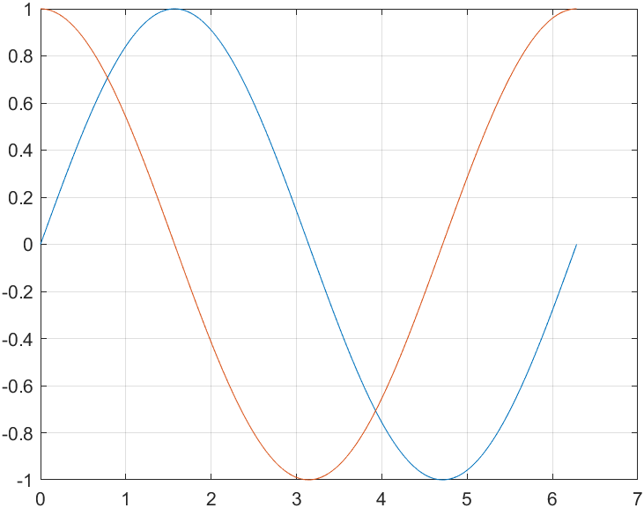
Multiple Graphs
First method:
t = 0:pi/100:2*pi;
y1=sin(t);
y2=sin(t+pi/2);
plot(t,y1,t,y2)
grid on
grid on adds major grid lines to the current axes.
grid off removes major and minor grid lines from the current axes.

Slide 37
Multiple Graphs
Second method (using the hold on command):
t = 0:pi/100:2*pi;
y1=sin(t);
y2=sin(t+pi/2);
plot(t,y1)
hold on
plot(t,y2)
grid on
hold on holds the current plot and all axis properties, including the current color and linestyle, so that subsequent graphing commands add to the existing graph without resetting the color and linestyle.
hold off returns to the default mode whereby PLOT commands erase the previous plots and reset all axis properties before drawing new plots.

Slide 38
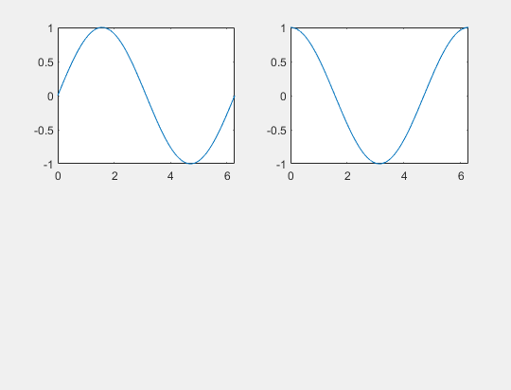
Multiple Plots
t = 0:pi/100:2*pi;
y1=sin(t);
y2=sin(t+pi/2);
subplot(2,2,1)
plot(t,y1)
subplot(2,2,2)
plot(t,y2)

Slide 39
Graph Functions (summary)
Function | Description
plot | linear plot
stem | discrete plot
grid | add grid lines
xlabel | add X-axis label
ylabel | add Y-axis label
title | add graph title
subplot | divide figure window
figure | create new figure window
pause | wait for user response

Slide 40
You can perform operations in MATLAB in two ways
In the interactive mode, in which all commands are entered directly in the Command window.
By running a MATLAB program stored in script file. This type of file contains MATLAB commands, so running it is equivalent to typing all the commands—one at a time—at the Command window prompt. You can run the file by typing its name at the Command window prompt.

Slide 41

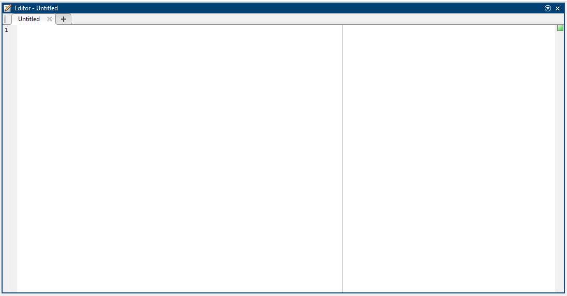
Scripts
The simplest type of MATLAB® program is called a script. A script is a file that contains multiple sequential lines of MATLAB commands and function calls. You can run a script by typing its name at the command line.
First click on the ”New Script” icon:
Then the editor window appears, where you can edit your script:

Slide 42

My first scripts
In the ”Editor” window you can write your script and save it on the local computer. (When saving the script do not forget about the naming regulations!)
Example for a simple script:
x=-5:0.01:5;
y=x.^2;
plot(x,y)
xlabel('Horizontal axis')
ylabel('Vertical axis')
title('The result of my first script is a Parabola')
After typing in the code you can run it, by clicking the ”Run” icon on the ”Editor” tab:
If the script wasn’t saved previously, Matlab asks you to save the script in an m file.
Let’s name the script parabola.

Slide 43
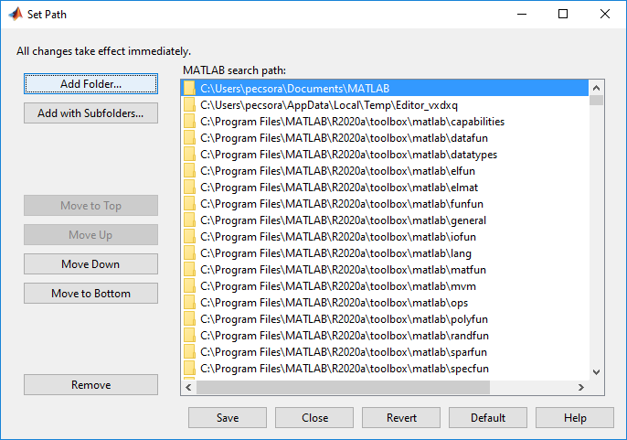
My first scripts
If you save it in a folder which is in the ”Path list”, then you can run the script by typing parabola in the ”Command Window”.
If the folder is not in the ”Path list”, you can add your folder, by clicking the ”Set Path” icon on the ”Home” tab.

Slide 44
Keep in mind when using script files
The name of a script file must begin with a letter, and may include digits and the underscore character, up to 63 characters.
Do not give a script file the same name as a variable.
Do not give a script file the same name as a MATLAB command or function. You can check to see if a command, function or file name already exists by using the exist command.

Slide 45
COMMENTS
The comment symbol may be put anywhere in the line. MATLAB ignores everything to the right of the % symbol. For example,
% This is a comment.
x = 2+3 % So is this.
x =
5
Note that the portion of the line before the % sign is executed to compute x.

Slide 46
Flow Control
if
for
while
break
…

Slide 47
Control Structures
If Statement Syntax
if (Condition_1)
MATLAB Commands
elseif (Condition_2)
MATLAB Commands
elseif (Condition_3)
MATLAB Commands
else
MATLAB Commands
end
Some Examples
if ((a>3) & (b==5)) disp('Some MATLAB Commands'); end
if (a<3) disp('Some MATLAB Commands'); elseif (b==5) disp('Some other MATLAB Commands'); end
if (a<3) disp('Some MATLAB Commands'); else disp('Some other MATLAB Commands'); end

Slide 48
Control Structures
Some Examples
s=0; for i=1:100 s=s+i; end s
s=0; for j=1:3:200 s=s+i; end s
s=0; for m=13:-0.2:-21 s=s+m; end s
s=0; for k=[0.1 0.3 -13 12 7 -9.3] s=s+k; end s
For loop syntax
for i=Index_Array
MATLAB Commands
end

Slide 49
Control Structures
While Loop Syntax
while (condition)
MATLAB Commands
end
Example
a=10; b=5; while ((a>3) & (b==5)) disp('a is greater then 3 and b is equal to 5.'); a=a-1; end

Slide 50
Literature
Ágnes Baran: Mathematics for engineers 1. (Laboratory slides)
Sándor Baran: Probability theory and statistics
Fazekas István: Valószínűségszámítás, Debreceni Egyetemi Kiadó, 2009
Fazekas István: Bevezetés a matematikai statisztikába, Debreceni Egyetemi Kiadó, 2009
Matlab examples: https://www.mathworks.com/help/examples.html

